Slide 1

Breaking the Ice: Spatial Capture-Recapture (SCR) for Snow Leopard Surveys in Karakoram
Max Riffi-Aslett, Misha Tseitlin
5 April 2024
MT5751 Assignment 4

Slide 2
Overview
Motivation
Snow Leopards and Existing Approaches
Methods
Survey Strategies and Spatial Capture-Recapture (SCR)
Results
Discussion
Implications and Limitations

Slide 3
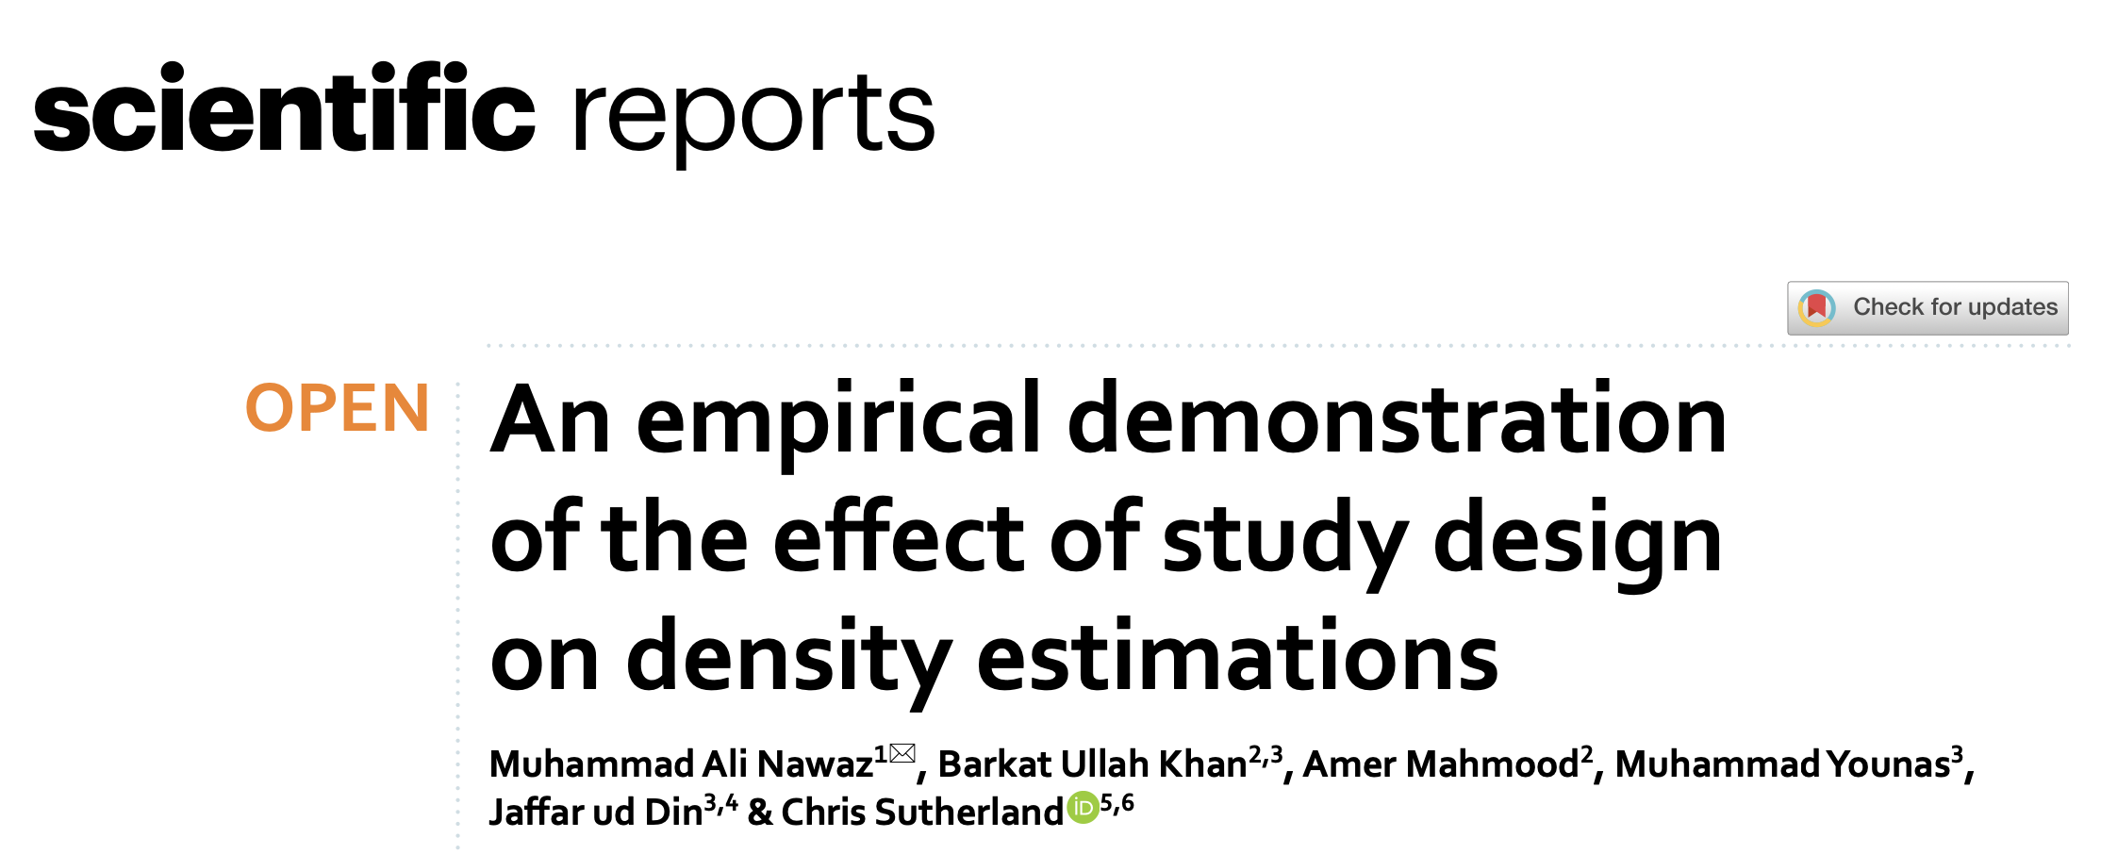
The Original Paper

Slide 4
Motivations
Snow leopards: sparce, high-interest, and individually-identifiable
Thus, low sample size and poor extensions of existing methods
Highly-mobile, yet genetically homogenous species
Current understanding of effective SCR study designs for difficult terrains and elusive wildlife is limited
Large snow leopard range in remote areas begets investigating suitability of various sampling approaches and effect on estimates
Most SCR analysis mainly estimates density and range
Based on “activity centres” and using spatial characteristics to parse out effects of detection ranges and probabilities from discrete traps
These may be better interpreted as maximum range estimates

Slide 5
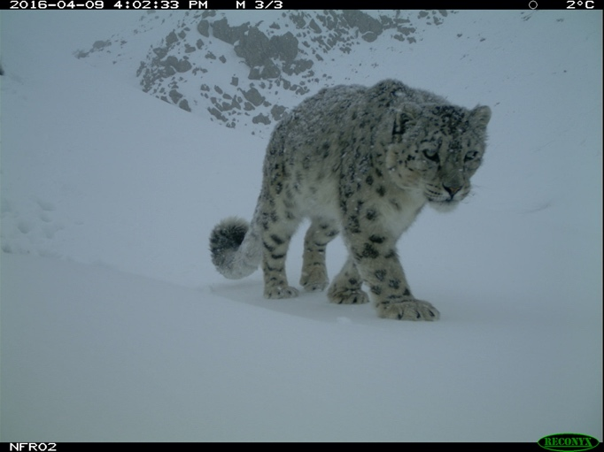
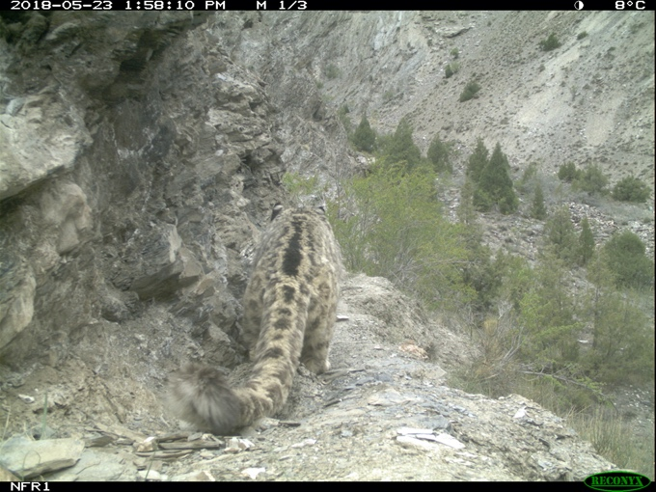
Snow Leopards Bharpu (L) and Baltoro (R)

Slide 6
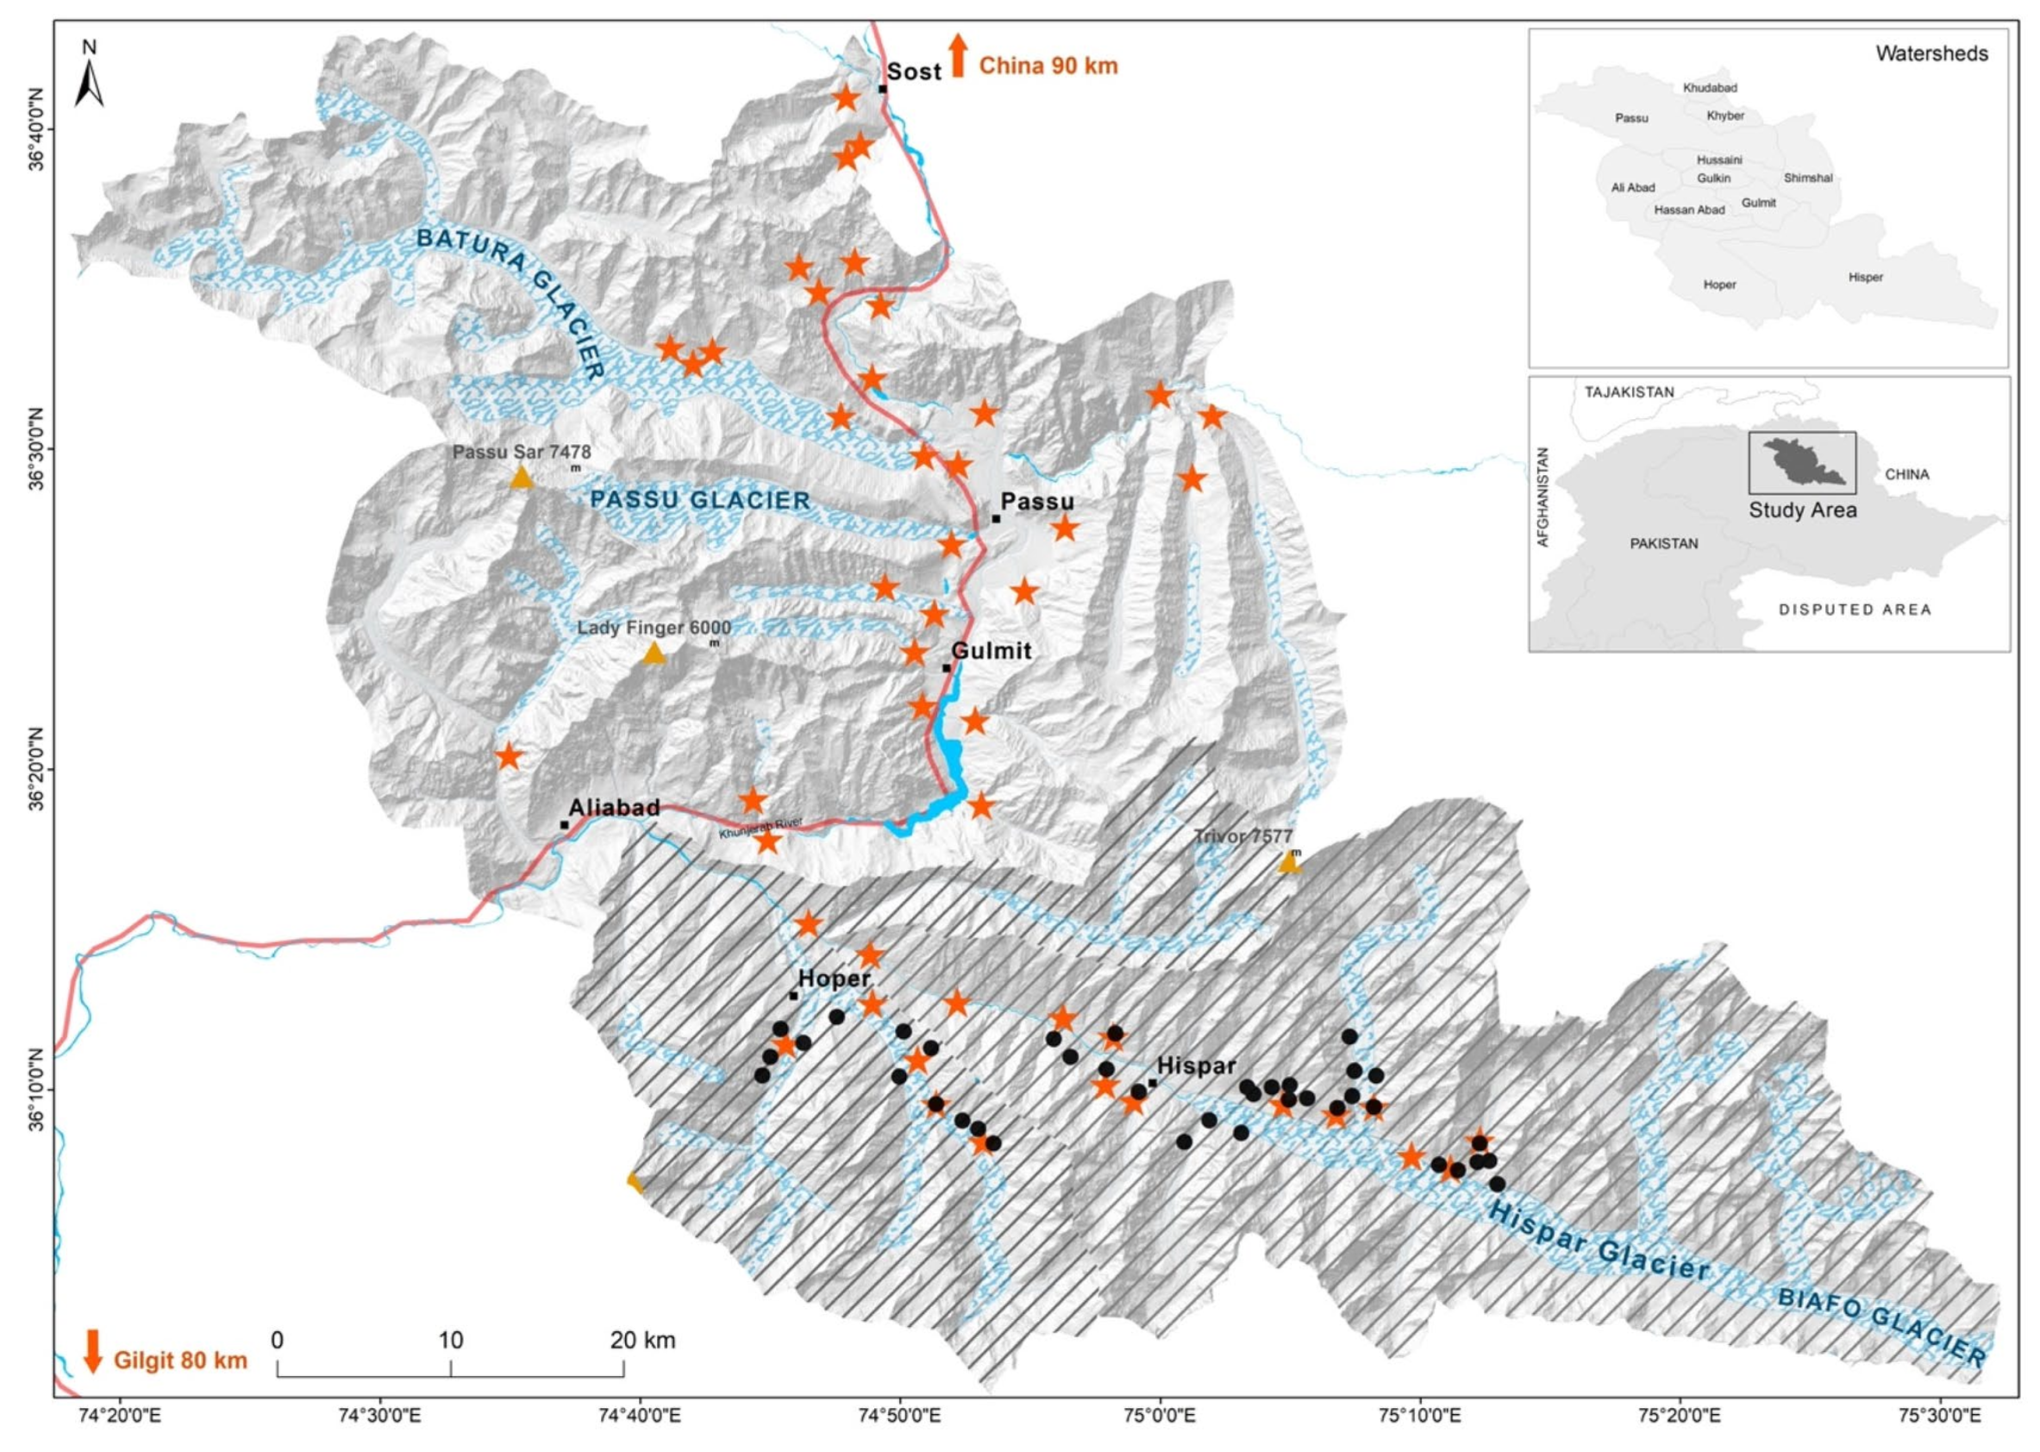
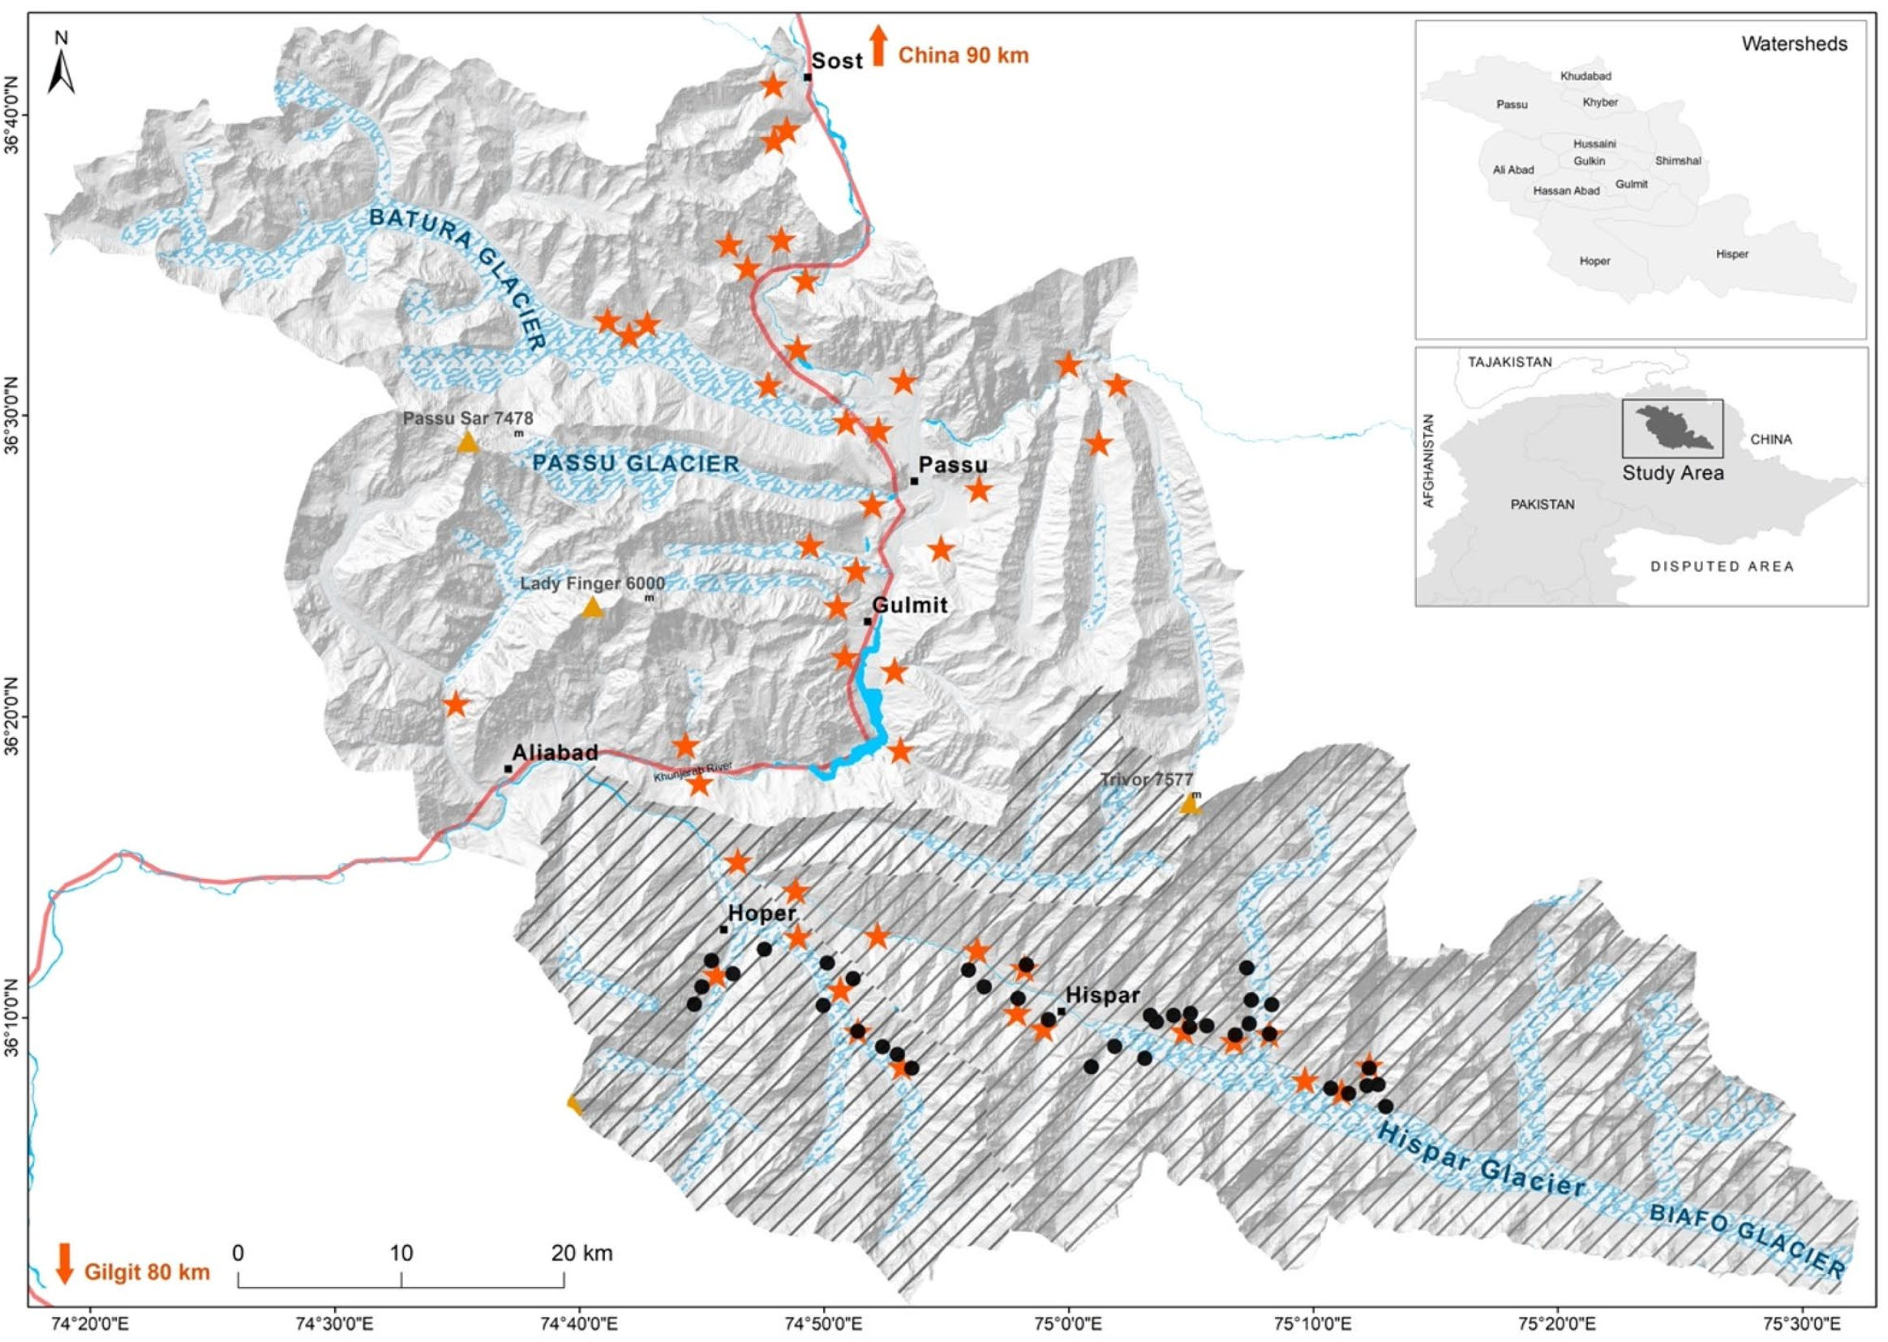
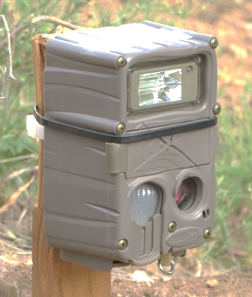
Methods: Surveying
^{Survey 1 (Compact Design):}
^{: locations of compact cameras}
^{Timeline: March to May (2016)}
^{Number: 38 cameras}
^{Spacing: 1km2}
^{Area: 253 km2}
Density: 15 cameras per 100 km2
Outcome: 27 independent capture events, 4 unique individuals
^{Survey 2 (Diffuse Design):}
: locations of diffused cameras
^{Timeline: April to June (2018)}
^{Number: 44 camera traps}
^{Spacing: 5km2}
^{Area: 2030 km2}
^{Density: 2 cameras per 100 km2}
Outcome: 21 independent capture events, and 9 unique individuals
Figure 1: Map of the study area indicating the positions of cameras using circles for compact designs and stars for diffused designs.⁹

Slide 7
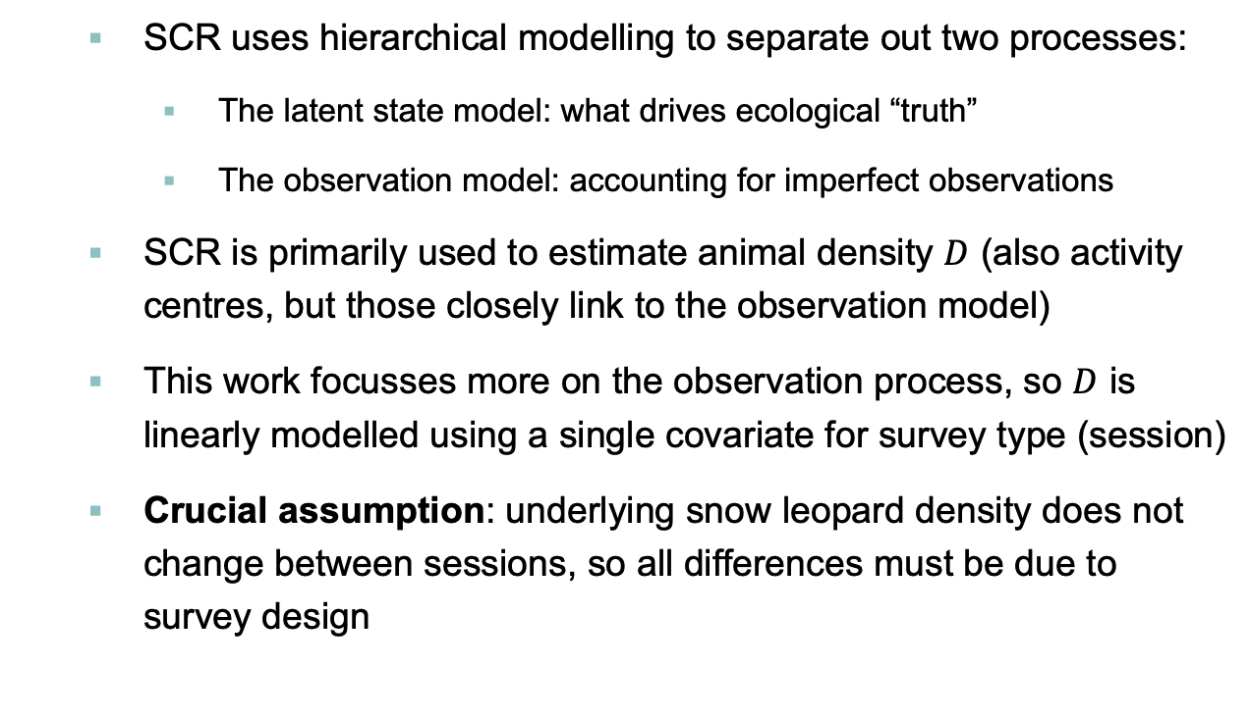
Methods: State Model
SCR uses hierarchical modelling to separate out two processes:
The latent state model: what drives ecological “truth”
The observation model: accounting for imperfect observations
SCR is primarily used to estimate animal density $D$ (also activity centres, but those closely link to the observation model)
This work focusses more on the observation process, so $D$ is linearly modelled using a single covariate for survey type (session)
Crucial assumption: underlying snow leopard density does not change between sessions, so all differences must be due to survey design

Slide 8
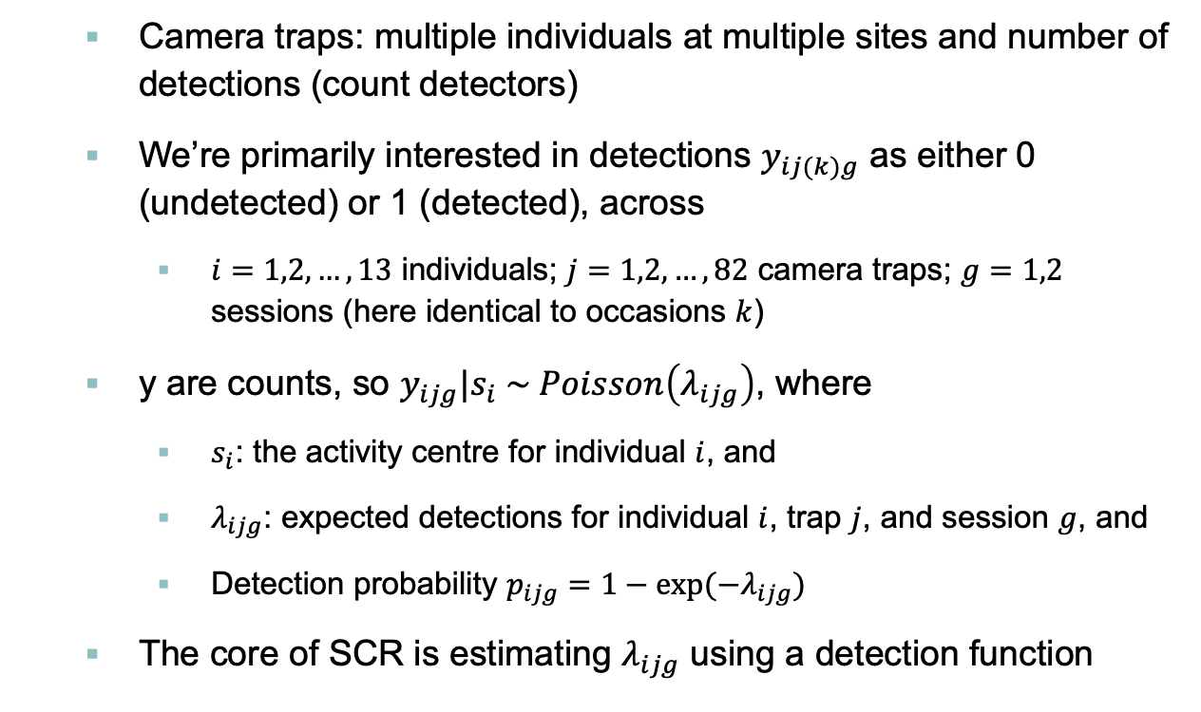
Methods: Observation Model
Camera traps: multiple individuals at multiple sites and number of detections (count detectors)
We’re primarily interested in detections $y_{ij(k)g}$ as either 0 (undetected) or 1 (detected), across
$i=1,2,…, 13$ individuals; $j=1,2,…, 82$ camera traps; $g=1,2$ sessions (here identical to occasions $k$)
y are counts, so $y_{ijg}|s_{i} \sim Poisson\left(λ_{ijg}\right)$, where
$s_{i}$: the activity centre for individual $i$, and
$λ_{ijg}$: expected detections for individual $i$, trap $j$, and session $g$, and
Detection probability $p_{ijg}=1−exp⁡(−λ_{ijg})$
The core of SCR is estimating $λ_{ijg}$ using a detection function

Slide 9
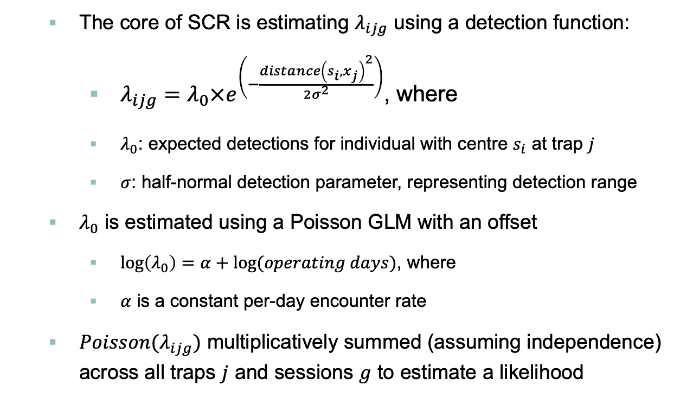
Methods: Observation Model
The core of SCR is estimating $λ_{ijg}$ using a detection function:
$λ_{ijg}=λ_{0}×e^{\left(−\frac{{distance\left(s_{i},x_{j}\right)}^{2}}{2σ^{2}}\right)}$, where
$λ_{0}$: expected detections for individual with centre $s_{i}$ at trap $j$
$σ$: half-normal detection parameter, representing detection range
$λ_{0}$ is estimated using a Poisson GLM with an offset
$\log\left(λ_{0}\right)=α+\log{(operating days)}$, where
$α$ is a constant per-day encounter rate
$Poisson(λ_{ijg})$ multiplicatively summed (assuming independence) across all traps $j$ and sessions $g$ to estimate a likelihood

Slide 10
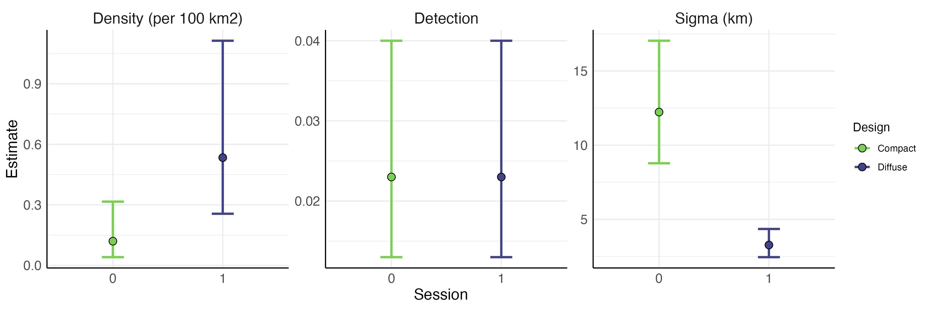
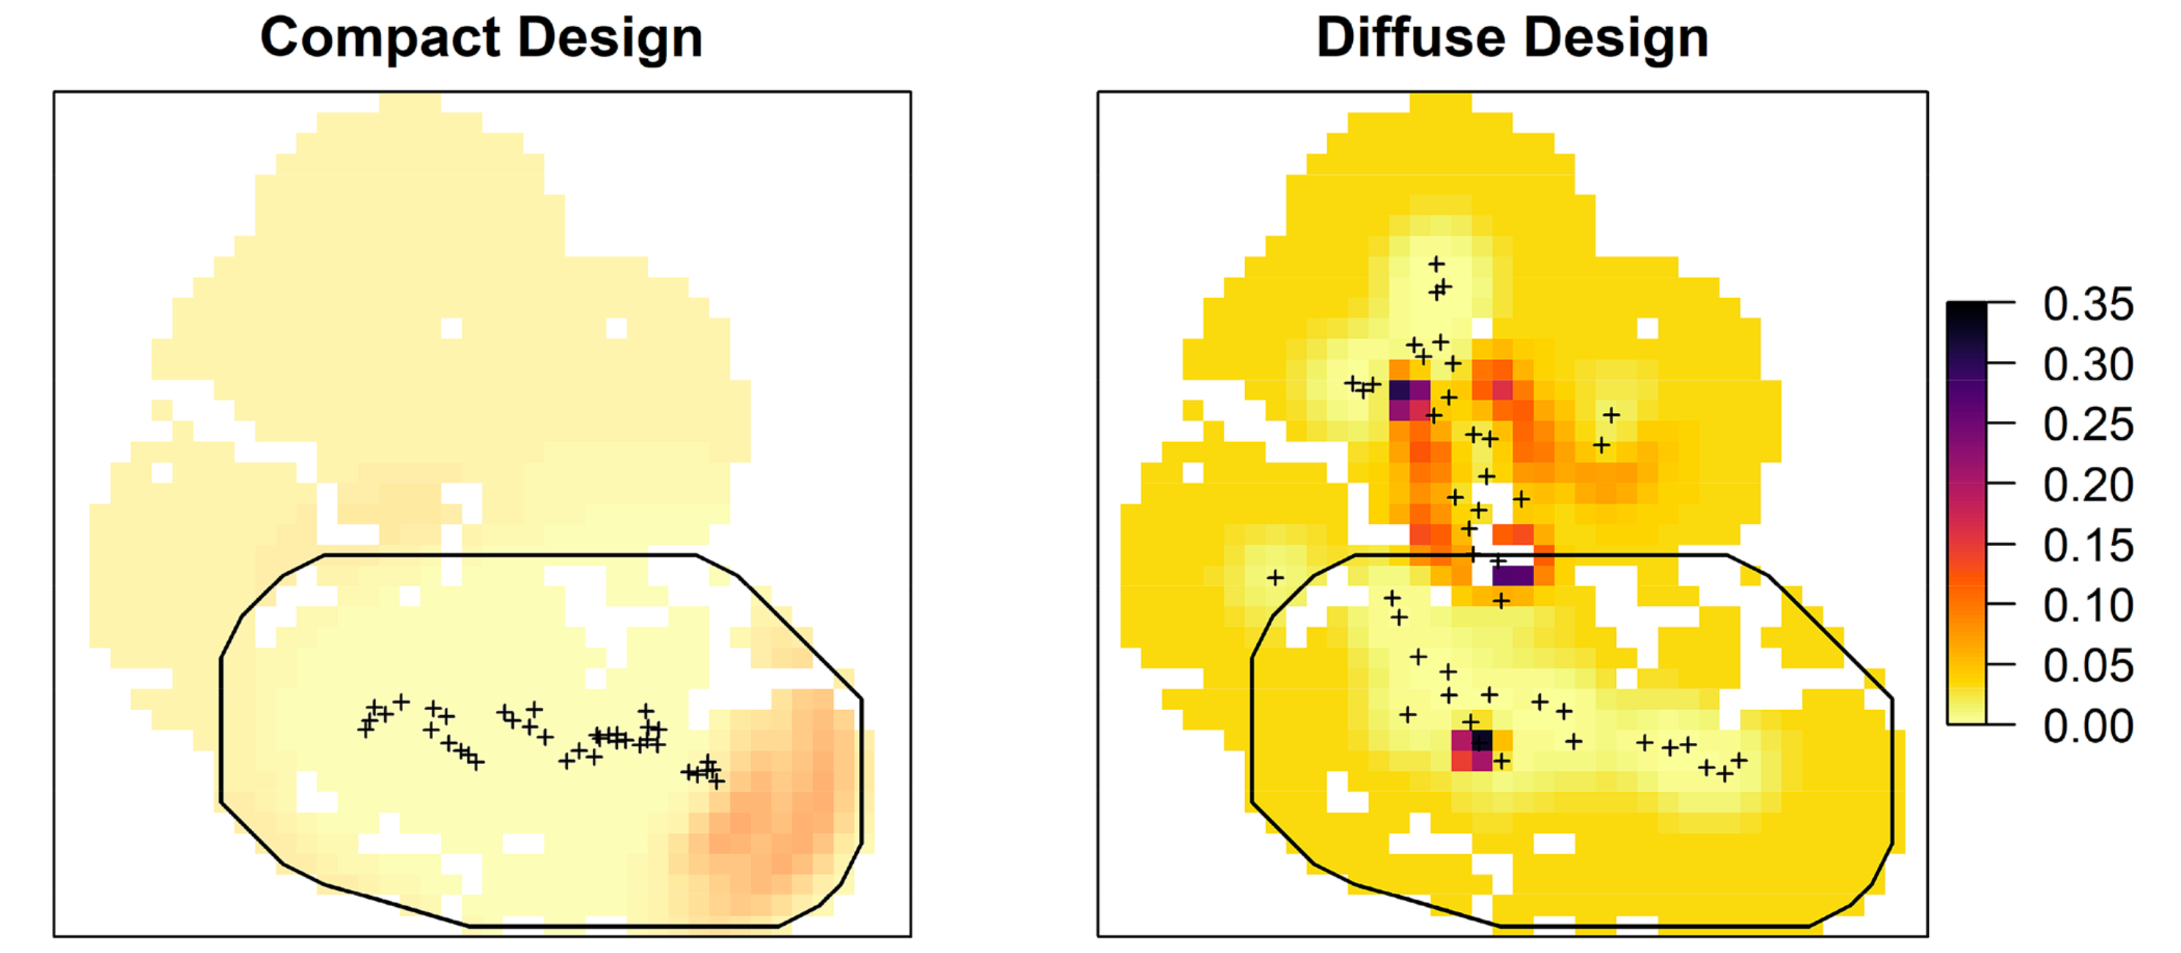
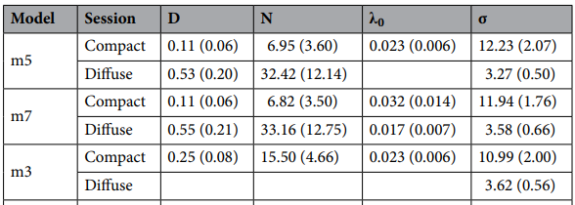
Results
Figure 2: Effect of design on SCR parameter estimates. Bars indicate 95% confidence intervals.⁹
Table 1: Parameter estimates of SCR. D density/100 km2 , Ν population, 0 detection probability, σ spatial scale parameter.⁹
Figure 3: Spatial snow leopard density estimates (per 100 km²) with trap locations as black crosses. Black polygon marks dense survey camera trapping area⁹
Estimated Home Range
Compact: 2764.23 km²
Diffuse: 201.22 km²

Slide 11
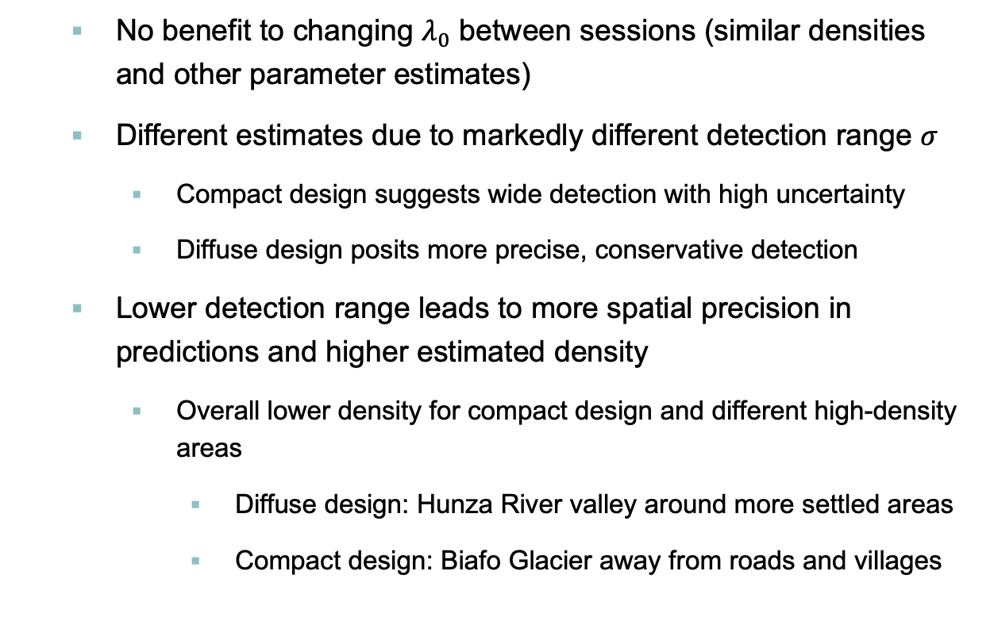
Results
No benefit to changing $λ_{0}$ between sessions (similar densities and other parameter estimates)
Different estimates due to markedly different detection range $σ$
Compact design suggests wide detection with high uncertainty
Diffuse design posits more precise, conservative detection
Lower detection range leads to more spatial precision in predictions and higher estimated density
Overall lower density for compact design and different high-density areas
Diffuse design: Hunza River valley around more settled areas
Compact design: Biafo Glacier away from roads and villages

Slide 12
Discussion
Authors recognise that given the sample size, both surveys are “at the limit of acceptability” for SCR
Clear differences in survey design on results: data collection can have a major impact on estimates
More work needed on maximum movement distances for snow leopards (a common rule of thumb; still no estimates)
Possible overestimation of movement in small study areas
Clear topographic differences in animal movement: non-circular ranges like under flat, homogenous topography
Density surface estimation may provide an interesting extension when more data becomes available

Slide 13
Discussion
Actual analysis is limited by assumptions and separability
p₀ (thus also λ₀) and σ react poorly to using the same covariates
Using a single covariate (survey type) prevents any inference or separation based on specific causes of cross-survey differences
Short survey time (3 months, 2 times) prevents estimates about migration and testing assumptions like closure
Some possible covariates that may challenge equal encounter rate and density:
Road density per 100 km² (0.0061, compact and 0.0265, diffuse)
Weather (precipitation, temperature) and local topography
Behaviour: leopards may become trap-happy after exposure to baited camera traps with castor oil during initial 2016 diffuse survey

Slide 14
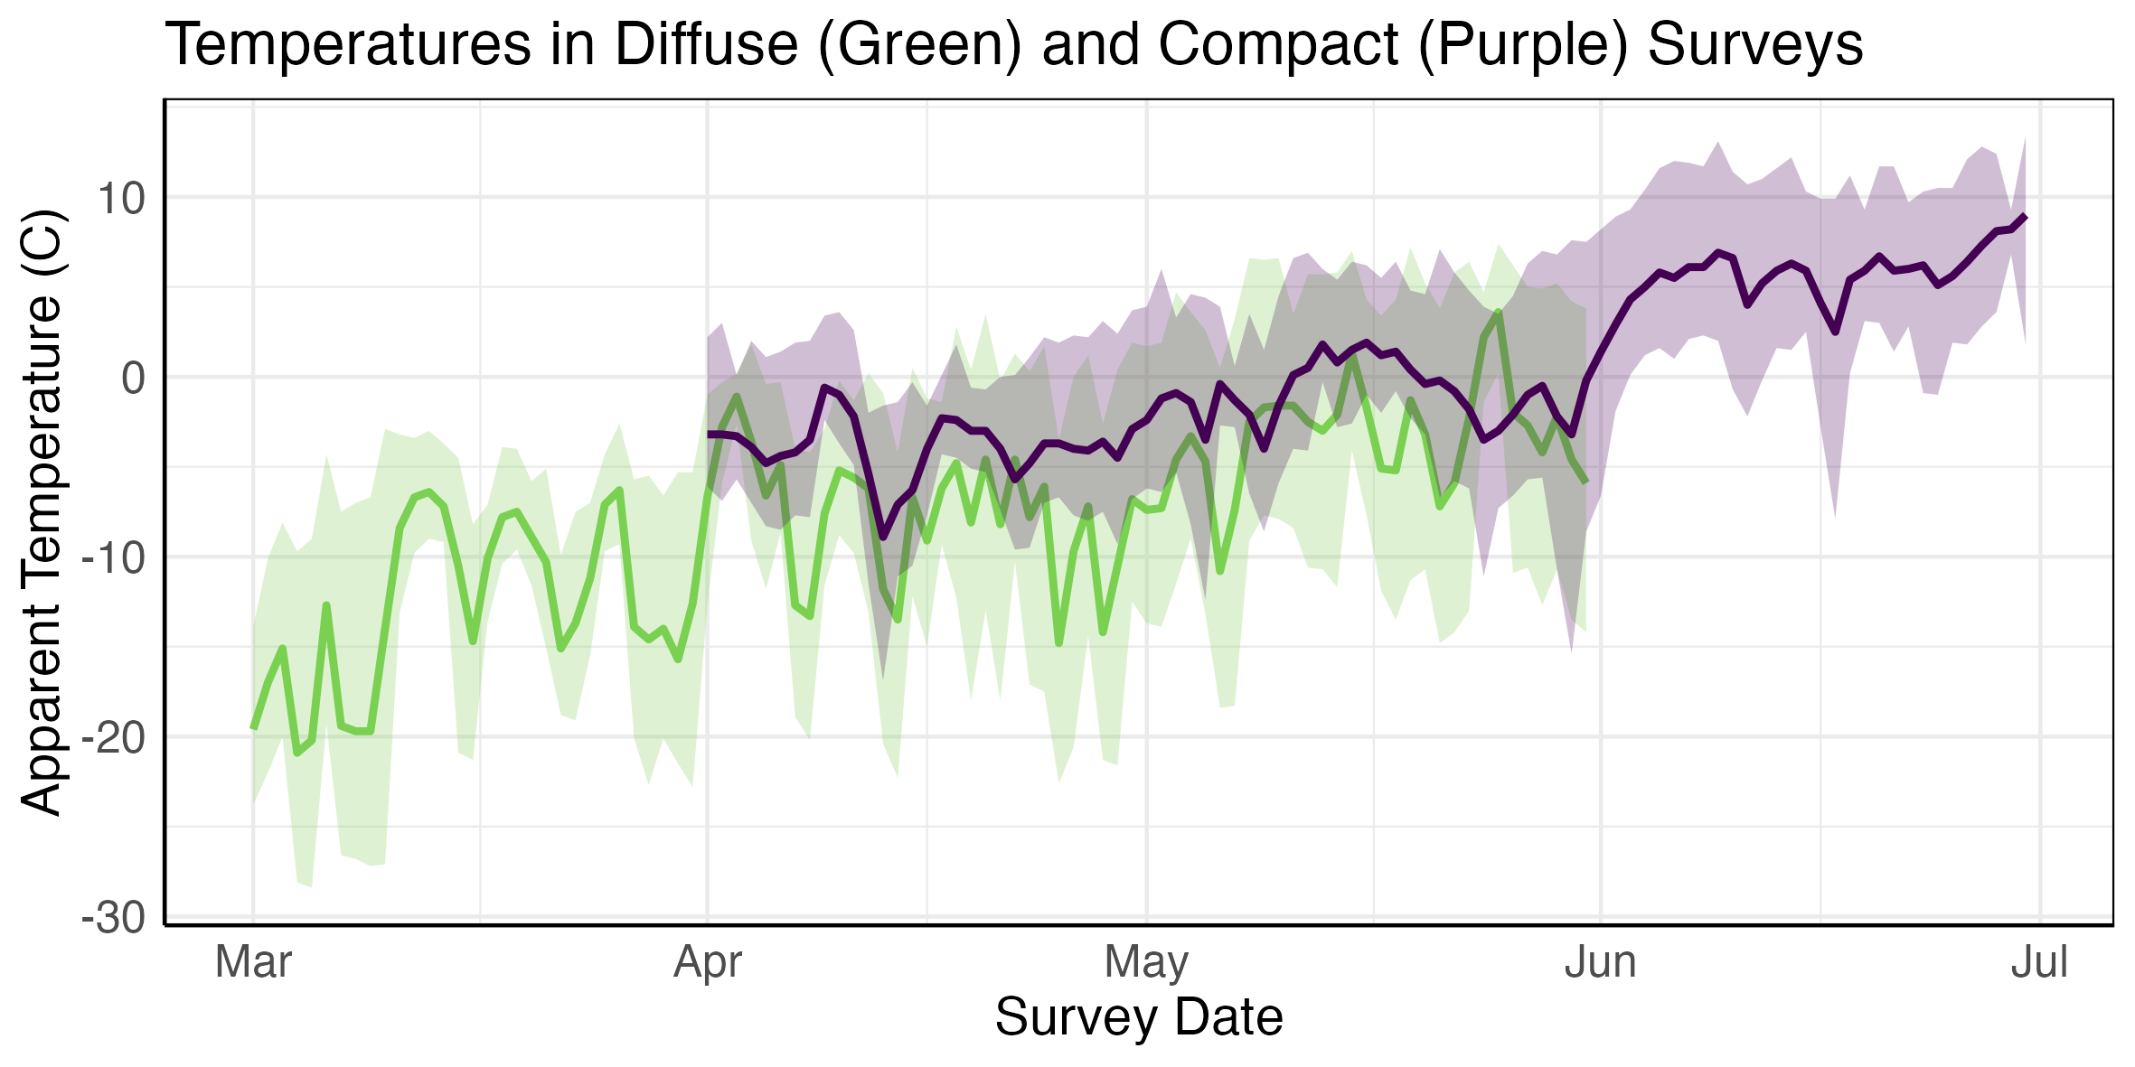
Discussion

Slide 15
Questions?

Slide 16
References
1. Pimenta, W. Viridis Palette Generator. waldyrious.net https://waldyrious.net/viridis-palette-generator/.
2. Spatial Capture-Recapture. (Academic Press, Boston, 2014). doi:10.1016/B978-0-12-405939-9.00021-9.
3. Spatial Capture-Recapture. in Spatial Capture-recapture (eds. Royle, J. A., Chandler, R. B., Sollmann, R. & Gardner, B.) iii (Academic Press, Boston, 2014). doi:10.1016/B978-0-12-405939-9.00022-0.
4. R Core Team. R: A Language and Environment for Statistical Computing. R Foundation for Statistical Computing (2023).
5. Cole, D. Parameter Redundancy and Identifiability. (Chapman and Hall/CRC, New York, 2020). doi:10.1201/9781315120003.
6. Zippenfenig, P. Open-Meteo.com Weather API. Open-Meteo.
7. Shrestha, B. & Kindlmann, P. Implications of landscape genetics and connectivity of snow leopard in the Nepalese Himalayas for its conservation. Sci Rep 10, 19853 (2020).
8. Oberosler, V. et al. First spatially-explicit density estimate for a snow leopard population in the Altai Mountains. Biodivers Conserv 31, 261–275 (2022).
9. Nawaz, M. A. et al. An empirical demonstration of the effect of study design on density estimations. Sci Rep 11, 13104 (2021).

